Slide 1
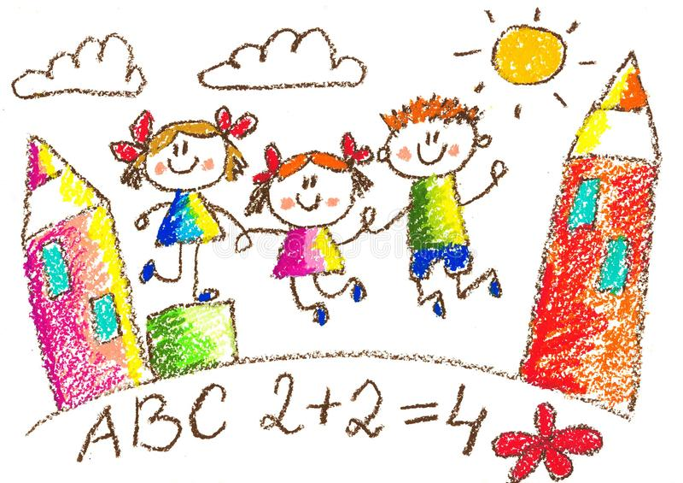
Project Name
Super Baby Website

Slide 2
Project description:
super baby is an interactive and educational website for kids represents to them very good and productive ways
for early learning at many fields and subjects .
Super baby website will have many ways for kids to learn including visual , mental and audible practices such as drawings , puzzles , writing and words pronouncing.

Slide 3
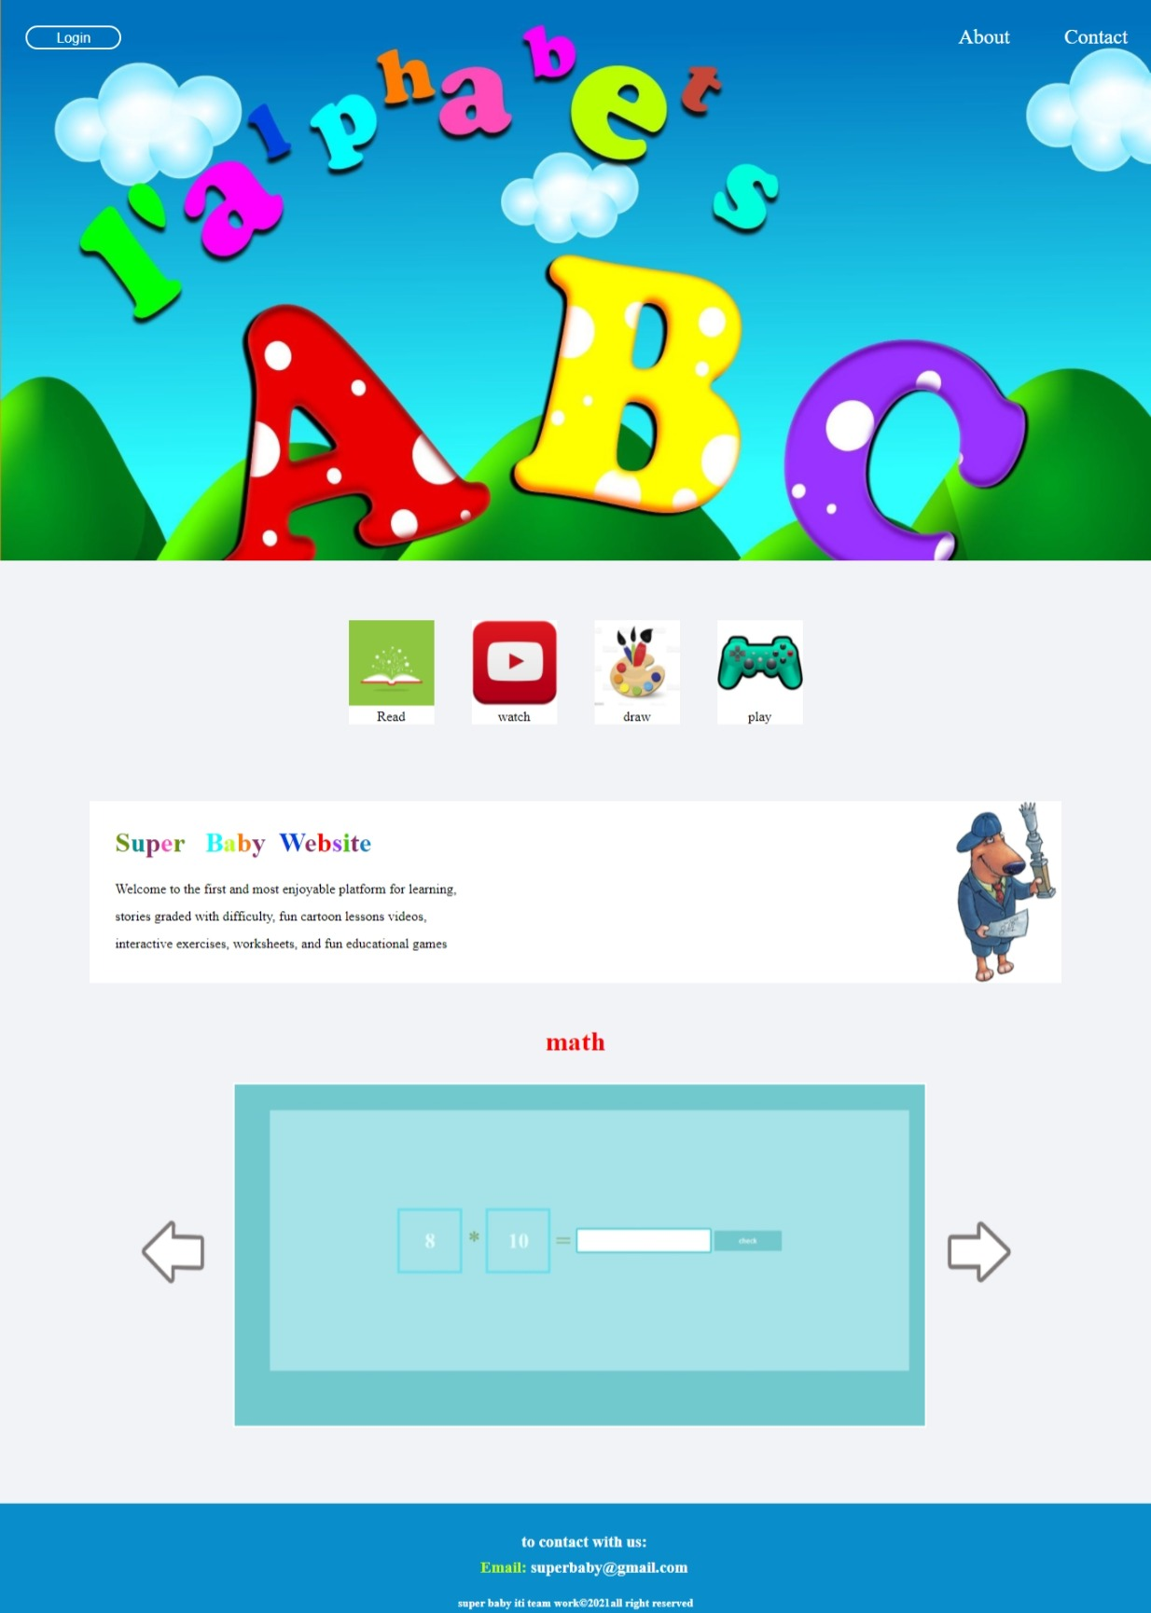
Contents of website
Home page :
Home page is introduction to super baby website that has some previews of the contents in the website which including games, entertainment videos, songs ,Stories , educational videos.

Slide 4
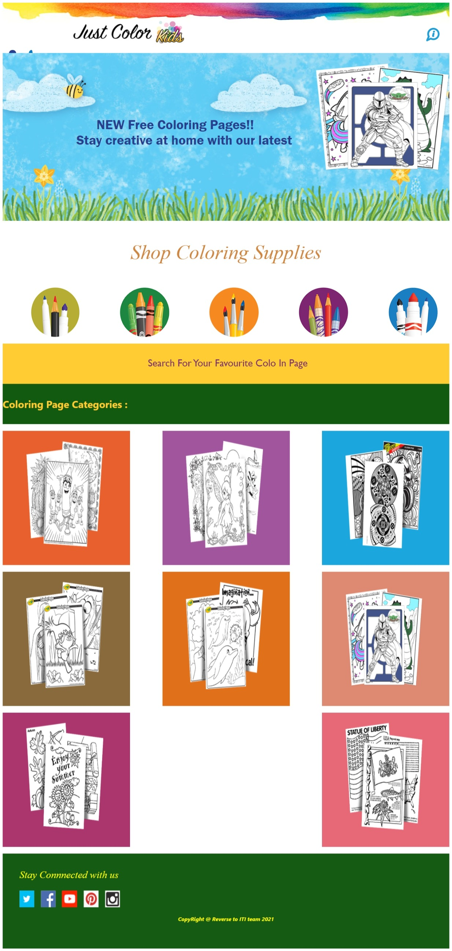
Cont. contents of website
Color & Draw :
Coloring website are widely used in
schooling for young children for
various reasons. For example,
children are often more interested in
coloring website rather than using
other learning methods; pictures
may also be more memorable than
simply words, Coloring may also
increase creativity in painting,
according to some research.

Slide 5
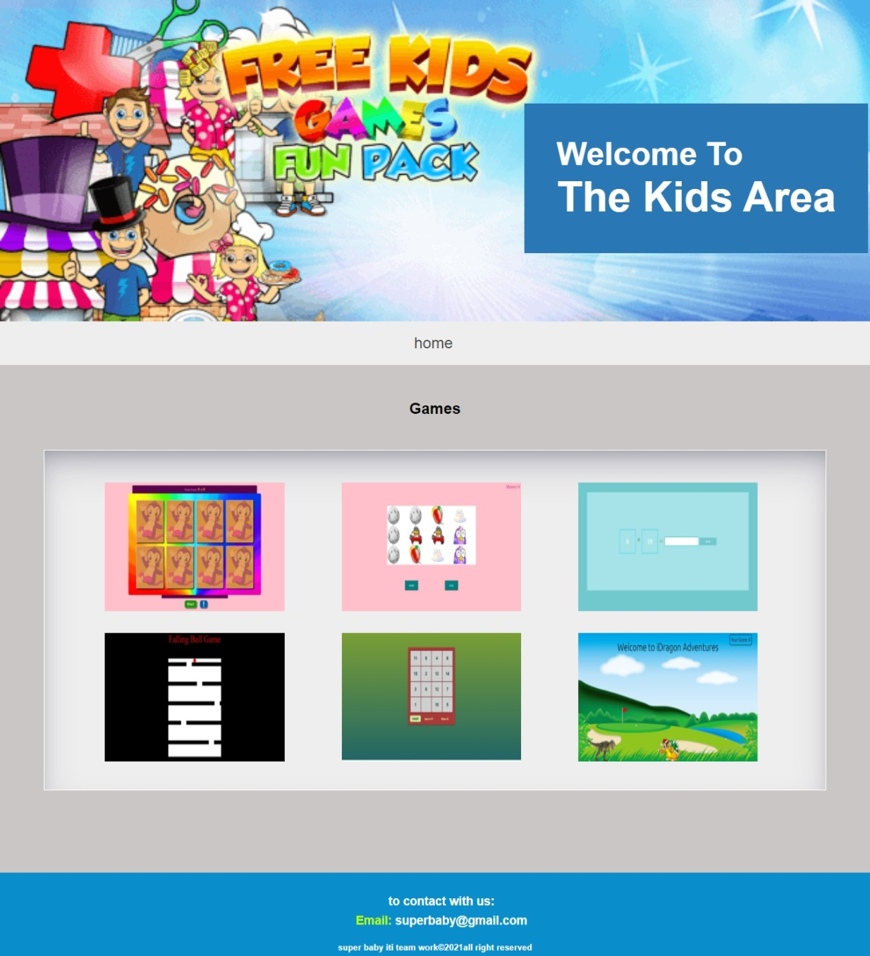
Cont. contents of website
Games:
A list of very similar games, with an explanation of the differences is a nice addition. The idea isn't to compare this game to every other game in the database, but very similar games that are not related
through some other relationship in the game's specifications children are often more interested in coloring website rather than using traditional ways .

Slide 6
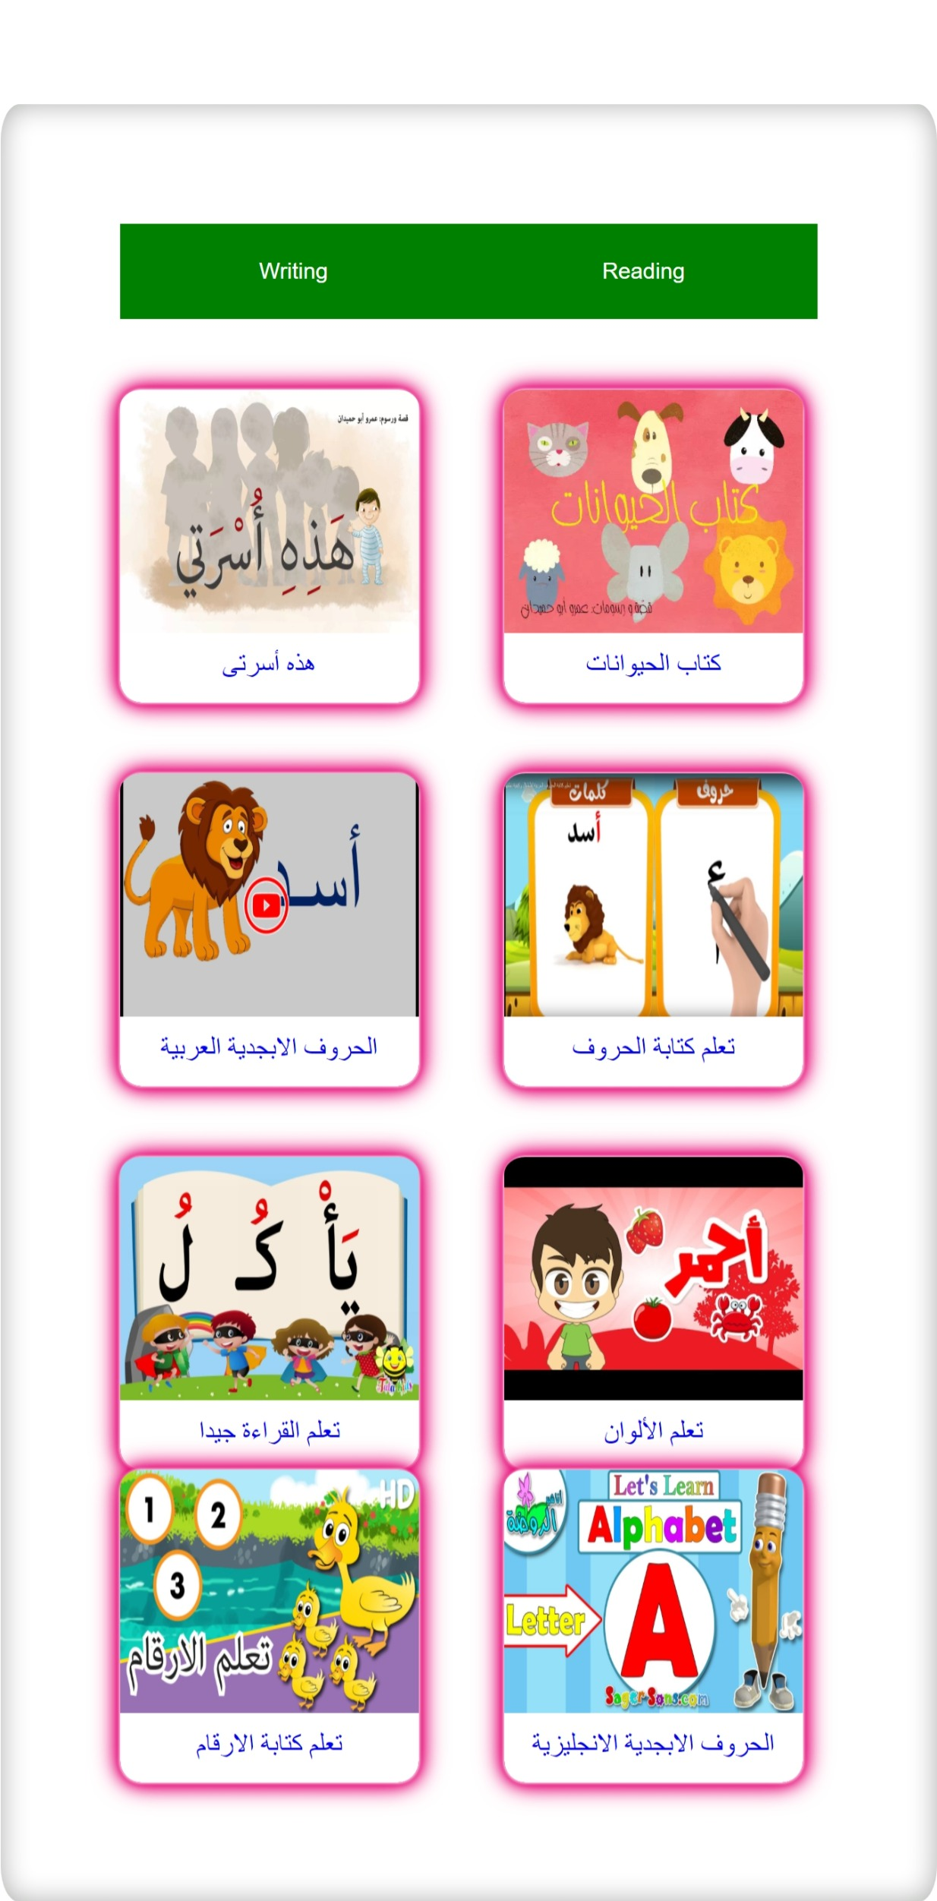
Cont. contents of website
Read & Write :
Page that has interactive educational contents that enables the children to read and write words,
Letters and numbers with enjoyable and funny
Ways by using various videos and readable stories

Slide 7
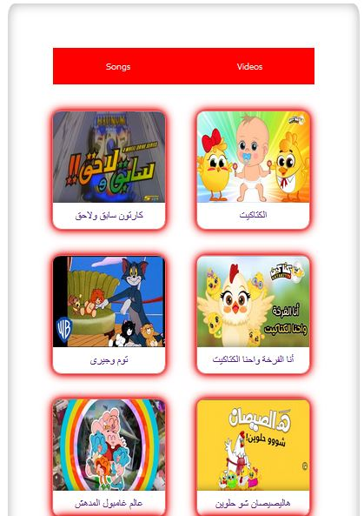
Cont. contents of website
Watch :
Page that has several videos for entertainment videos ,cartoons and animation shows and songs with animation and lyrics.

Slide 8
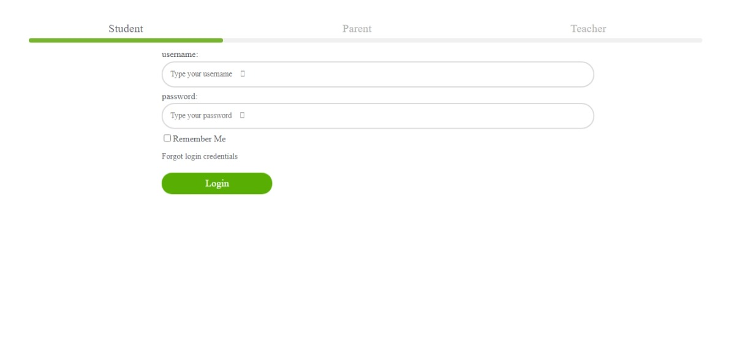
Cont. contents of website
Login :
Login page is specified to storage users data and get any contents anytime they want whether it was student, parent or teacher.

Slide 9
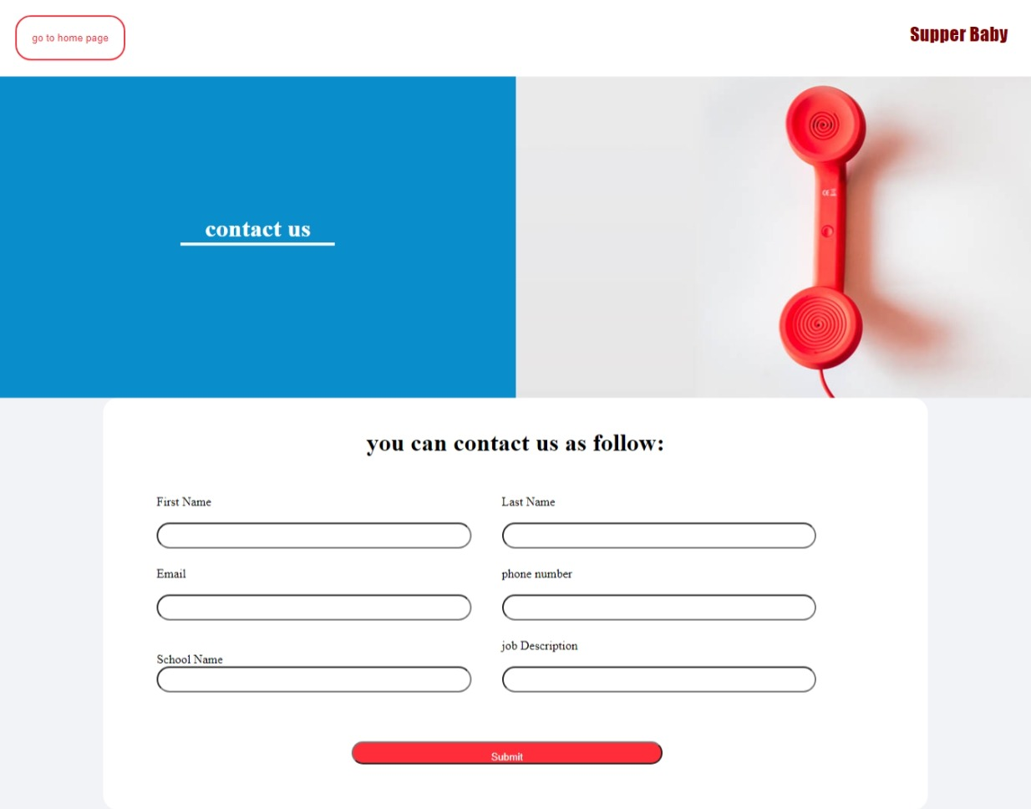
Cont. contents of website
Contact us :
Contact us page is for
Any help for any kind
Of user to provide to them in suggestions or
If they having a problem with something.

Slide 10
Future work​
1-website more dynamic
2-adding new features like (games-level)
3-adding animation and dynamic drawing by her/his hand
4-mobile application for website

